Slide 1
Evaluating the Direct, Indirect, and Community-level Effects of LLINs across Transmission Intensities
AIM Group Meeting
Zenabu Suboi
March 2026

Slide 2
Outline
Introduction
Methods
Results
Feedback

Slide 3
Introduction

Slide 4
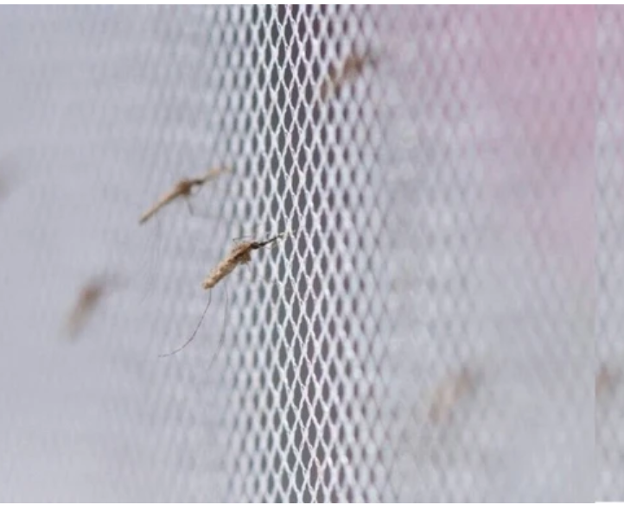
Background – LLIN effectiveness
663 million clinical cases averted from 2000 – 2015 globally
Gains attributed largely to LLINs
effectiveness of LLINs arises from two complementary mechanisms:
physical prevention of mosquito bites
insecticidal action that kills or deters mosquitoes

Slide 5
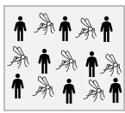
the concept of community protection
LLINs offer different benefits for users and non-users within a population
No LLIN use

Slide 6
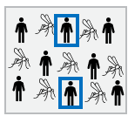
the concept of community protection
LLINs offer different benefits for users and non-users within a population
net-users receive personal protection while both users
non-users benefit from indirect (community-level) protection
reduced mosquito density, lifespan, and proportion of infectious mosquitoes
No LLIN use
X% LLIN use

Slide 7
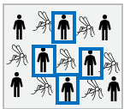
the concept of community protection
LLINs offer different benefits for users and non-users within a population
net-users receive personal protection while both users
non-users benefit from indirect (community-level) protection
reduced mosquito density, lifespan, and proportion of infectious mosquitoes
non-users may experience reduced malaria risk due to decreased transmission intensity in the population
This concept is known as community protection
No LLIN use
X% LLIN use
Increased LLIN use

Slide 8

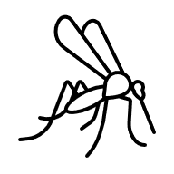

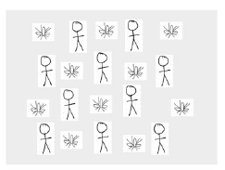
Rough work
Notes:
Nobody uses a net in the control scenario, and this is used as the counterfactual to
compare the other scenarios against (users and non-users at LLIN usage>0 and different EIR values )

Slide 9
evidence of community protection
Evidence from both empirical and modelling studies
These evidences indicate that
indirect effects are heterogeneous and sensitive to local transmission dynamics, intervention coverage, and vector ecology
community protection from nets varying by spatial scale and local coverage levels in multiple African settings

Slide 10
what this study focuses on
the magnitude and reliability of community protection from LLINs remain incompletely characterized across epidemiological settings
we use a transmission-dynamic malaria model in this study to quantify the direct and indirect effects of LLIN usage across a wide range of transmission intensities

Slide 11
Approach

Slide 12
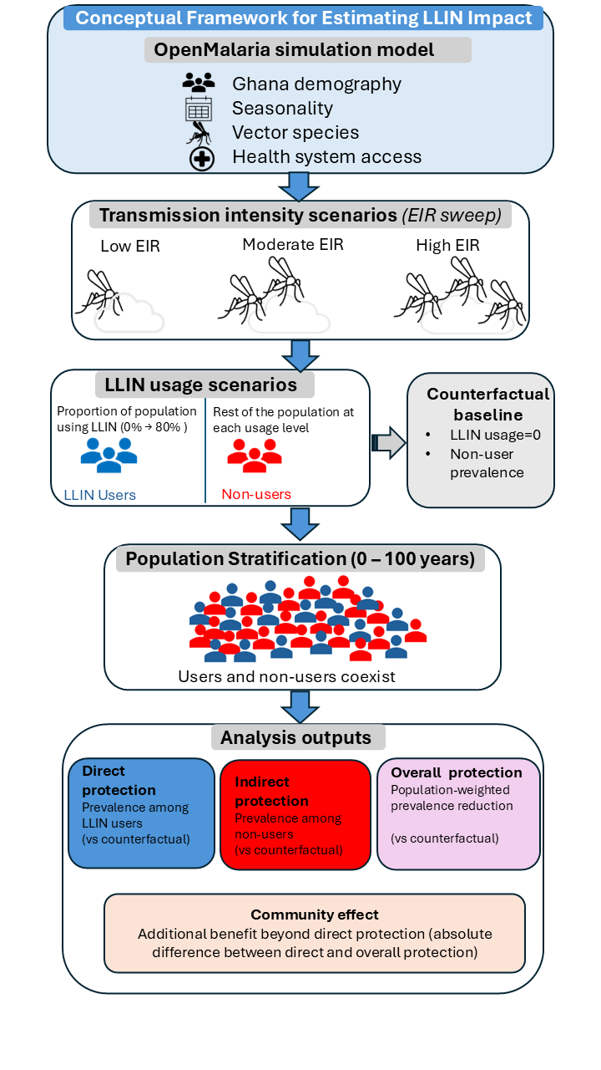
Approach
Notes:
Nobody uses a net in the control scenario, and this is used as the counterfactual to
compare the other scenarios against (users and non-users at LLIN usage>0 and different EIR values )

Slide 13
Results

Slide 14
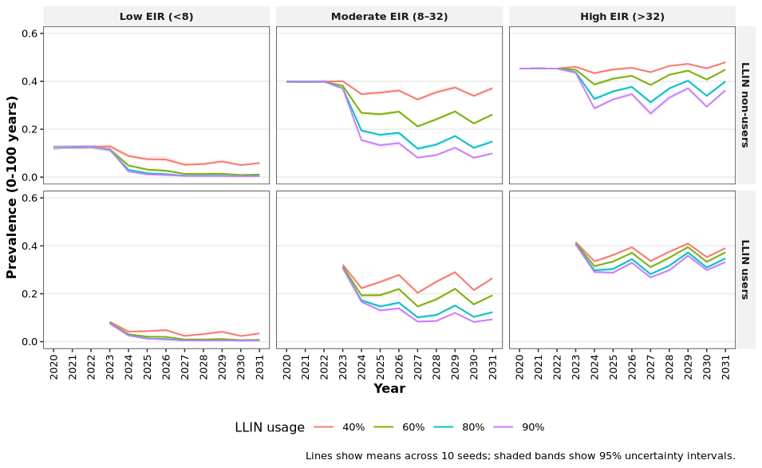
An increase in LLIN usage leads to a decline in prevalence across transmission intensities for both users and non-users
Image caption title.
Notes:
Temporal trends for two LLIN distribution cycles (in 2024 and 2027) indicated that malaria prevalence declined over time with increasing LLIN usage across all transmission intensities (EIR), with the steepest declines observed shortly after intervention deployment (Figure 2)

Slide 15
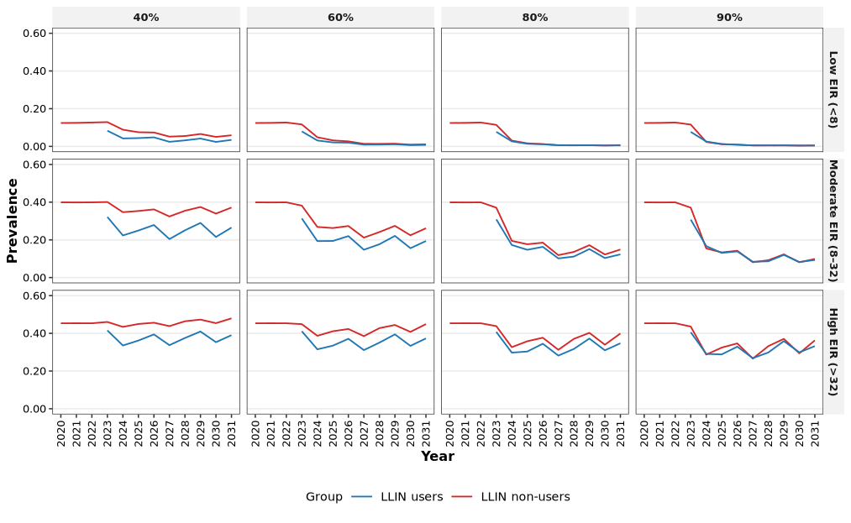
Malaria prevalence declined over time with increasing LLIN usage - three LLIN distribution cycles (in 2023, 2026 and 2027)
Image caption title.
Notes:
Temporal trends for two LLIN distribution cycles indicated that malaria prevalence declined over time with increasing LLIN usage across all transmission intensities (EIR), with the steepest declines observed shortly after intervention deployment (Figure 2)

Slide 16
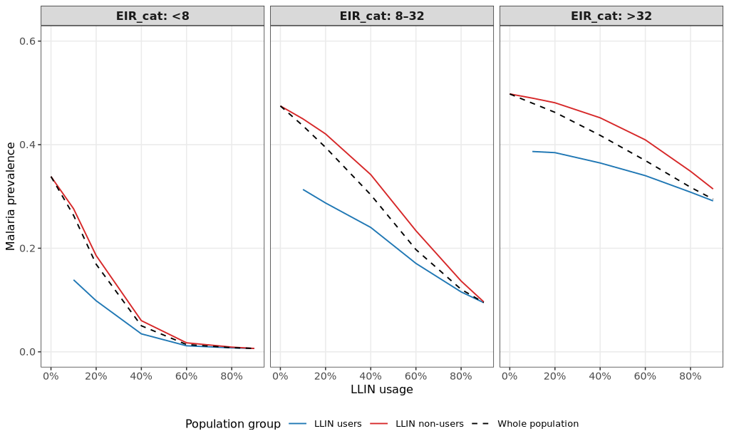
Malaria prevalence
Image caption title.

Slide 17
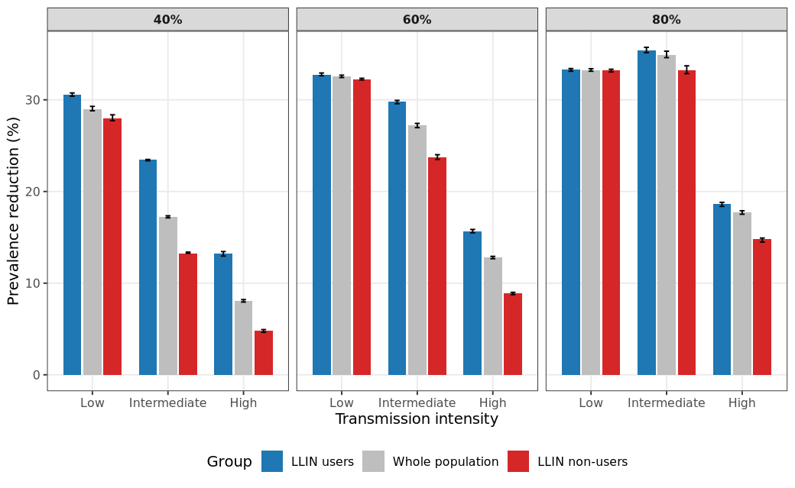
Malaria prevalence reduction
Image caption title.

Slide 18
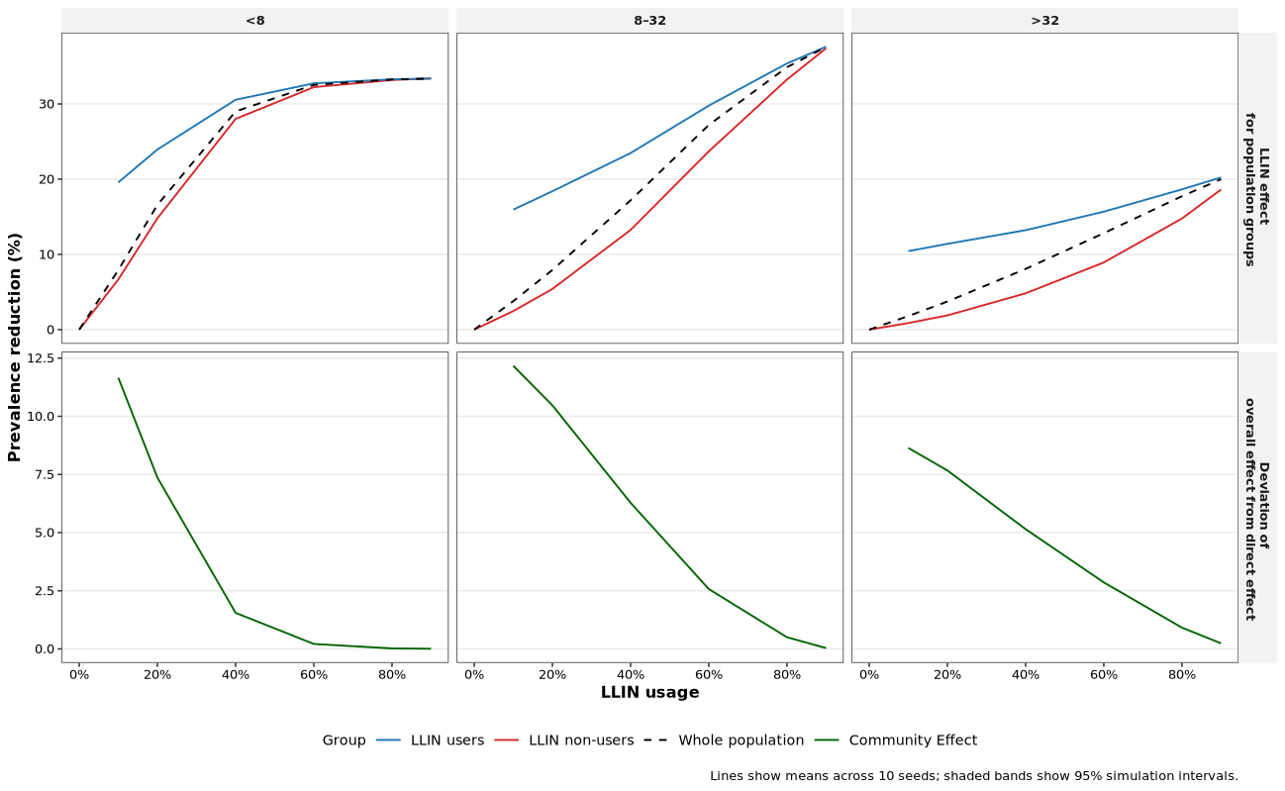
Malaria prevalence reduction
Image caption title.
Notes:
Temporal trends for two LLIN distribution cycles (in 2024 and 2027) indicated that malaria prevalence declined over time with increasing LLIN usage across all transmission intensities (EIR), with the steepest declines observed shortly after intervention deployment (Figure 2)

Slide 19
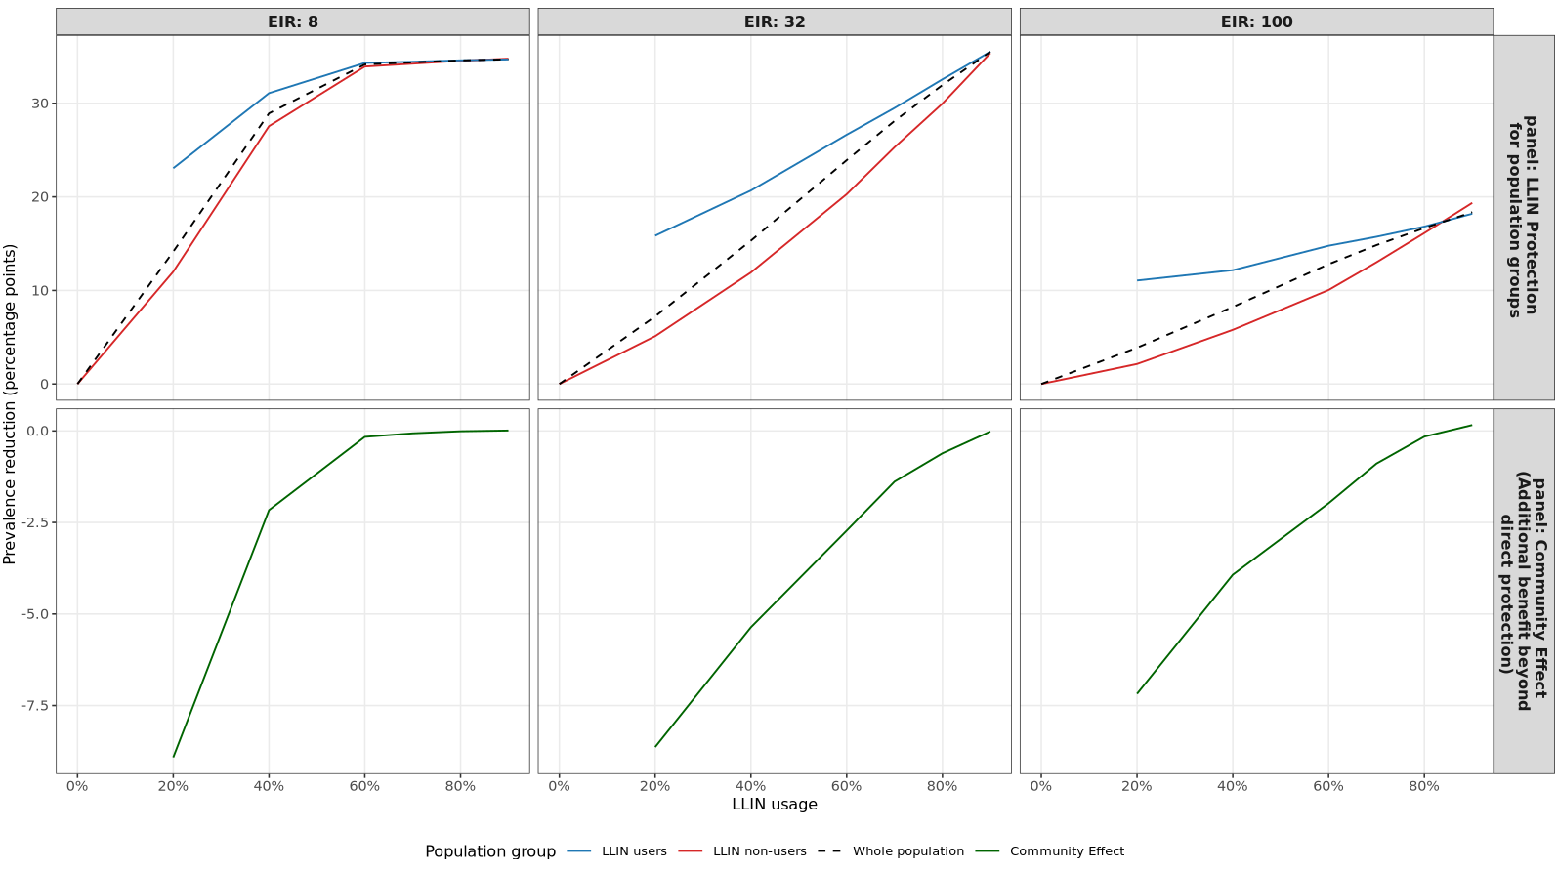
Malaria prevalence reduction
Image caption title.
Notes:
Temporal trends for two LLIN distribution cycles (in 2024 and 2027) indicated that malaria prevalence declined over time with increasing LLIN usage across all transmission intensities (EIR), with the steepest declines observed shortly after intervention deployment (Figure 2)

Slide 20
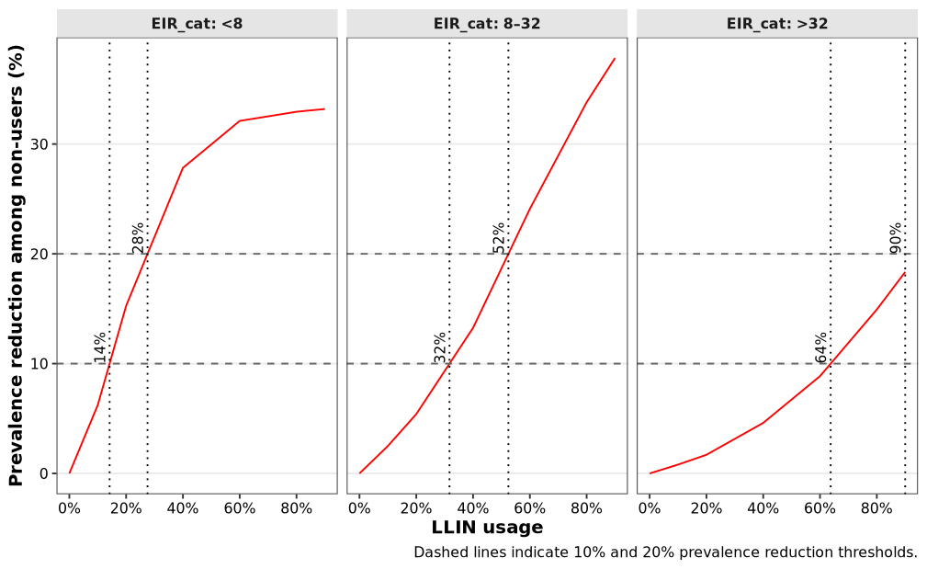
Coverage required to obtain 10% and 20% reductions among non-users
Image caption title.

Slide 21
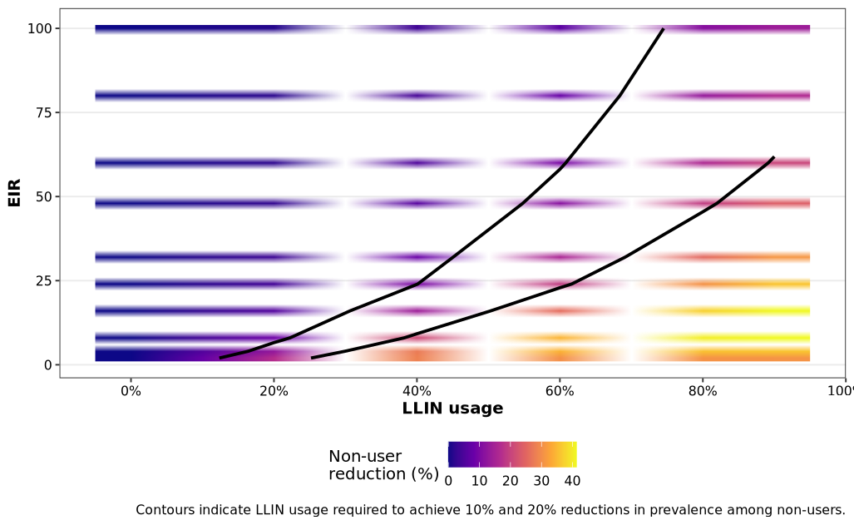
Coverage required to obtain 10% and 20% reductions among non-users
Image caption title.
Notes:
Temporal trends for two LLIN distribution cycles (in 2024 and 2027) indicated that malaria prevalence declined over time with increasing LLIN usage across all transmission intensities (EIR), with the steepest declines observed shortly after intervention deployment (Figure 2)

Slide 22
Thank you for your attention
Zenabu Suboi
AIM Group

